Slide 1

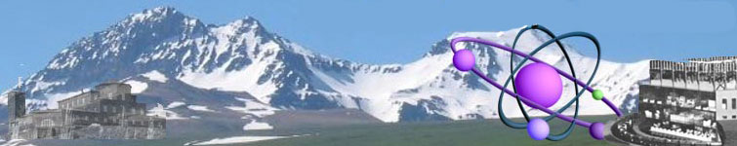


N* Transition form factors in a light-cone relativistic quark model.
I.G. Aznauryan^{1,2} and V.D. Burkert¹
¹ Jefferson Lab
² Yerevan Physics Institute
Outline:
Motivation
The model: q³ + meson cloud
Description of elastic form factors
N* transition form factors at Q² ≤ 5 GeV²
Predictions for Q² > 5 GeV²
Conclusions/Outlook

Slide 2
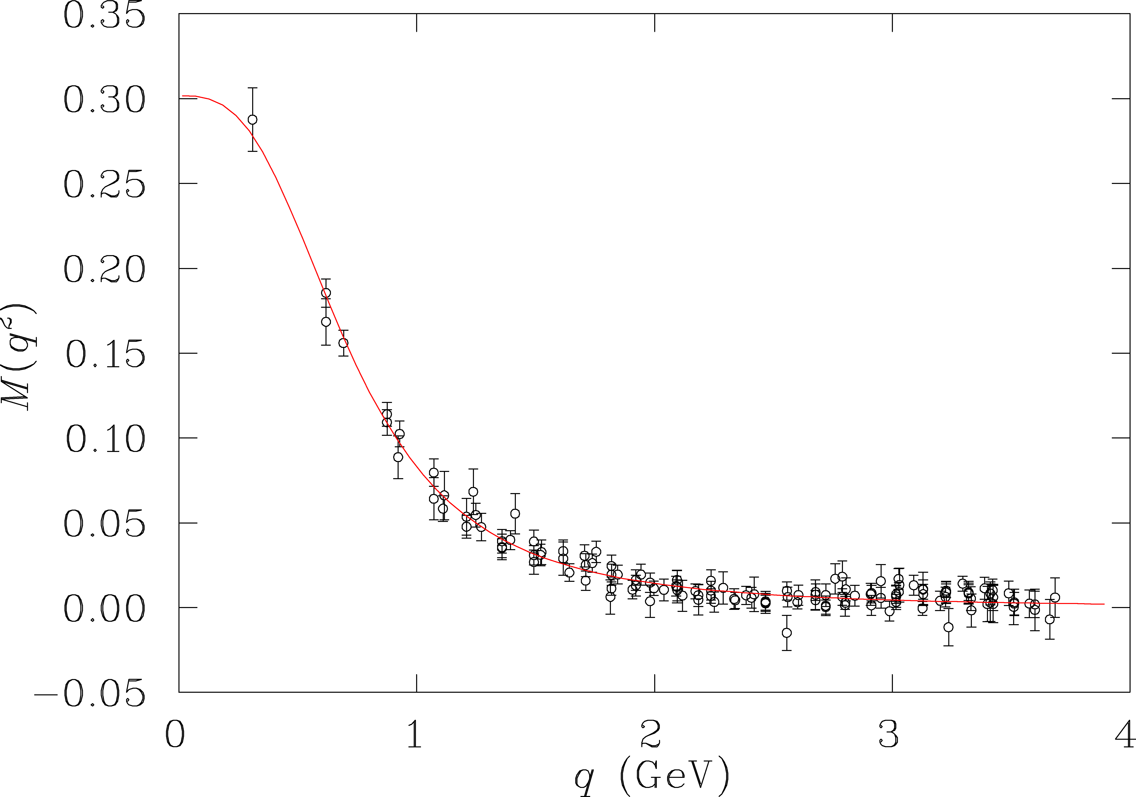
Motivation
What are the relevant degrees of freedom at varying distance scales?
π
resolution
of probe
low
N
DSE & LQCD
quark mass (GeV)
high
Do measurements of N* transition form factors probe m_{q}(q)?

Slide 3
Electroexcitation of Nucleon Resonances
We have now precise experimental information on the Q² dependence of transition amplitudes for several lower mass excited states for Q² < 4.5-7 GeV²
L_{3q}
Analyses based on ~120,000 Nπ cross sections, and beam, target, and double spin asymmetries.
2
SU(6)×O(3)
e’
γ_{v}
π, η, ππ
e
N*,△*
N
N’
1
N(1520)D₁₃
N(1535)S₁₁
A_{1/2}, A_{3/2}, S_{1/2}
M, E, S multipoles
=> talks by V. Mokeev, M. Jones
0
Δ(1232P₃₃
N(940)P₁₁
N(1440)P₁₁
0
1
2
N

Slide 4
Model ingredients
Nearly massless Goldstone bosons (pions) create loop contributions to electromagnetic form factors at relatively small Q². They are crucial for the description of G_{En}(Q²) and the magnetic dipole form factor G*_{M}(Q²) of the Δ(1232).
Electromagnetic NN* transition form factors must include contributions from the quark core and from the pion loops (pion cloud).
π
π
Light-front dynamics realizes Poincare invariance and allows for the description of the vertices N,N* -> q³, Nπ through wave functions.
Notes:
We have significant evidence for the presence of a pion cloud from electric form factor of the neutron and the excitation of the Delta resonance.

Slide 5
Model ingredients, cont’d
Prior work on light-front relativistic model for bound states:
Berestetski, Terentiev, Yad.Fiz. 24,1044 (1976); Yad.Fiz. 25,653 (1977)
Aznauryan et al., Phys.Lett. B112, 393( 1982); Aznauryan, Phys.Lett. B316, 391 (1993)
G. Miller computed pion-loop contributions for the nucleon e.m. form factor in LF model.
G. Miller, Phys.Rev. C66, 032201 (2002)

Slide 6
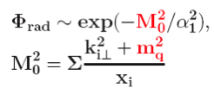
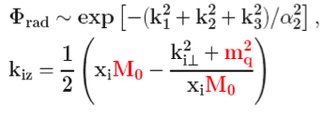
Model ingredients, cont’d
To study sensitivity to the form of the quark wave function, we employ two widely used forms for the 3-quark radial wave function,
and
(I)
(II)
S. Capstick and B. Keister, PRD51, 3598, 1995
M₀ – invariant 3-quark mass
m_{q} and k_{i} – quark mass and transverse momentum in light-front frame
=> Φ_{rad} increases as m_{q} decreases
Oscillator parameters α₁ and α₂ are chosen to give the same wave function in
non-relativistic approximation.
T

Slide 7
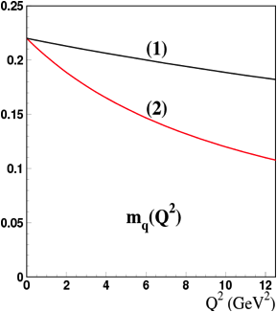
Running quark mass m_{q}(Q²)
The quark mass value of m_{q}(0)=0.22GeV
is taken from the description of baryon and meson masses (S. Capstick, N. Isgur).
To describe electromagnetic form factors and N* transitions, we use functional forms (1) and (2) of m_{q}(Q²) to test N* transition FF sensitivity to m_{q}(Q²).
m_{q}(Q²) = m_{q}(0)/(1+Q²/Λ)
(1) Λ = 60GeV²
(2) Λ = 10GeV²

Slide 8
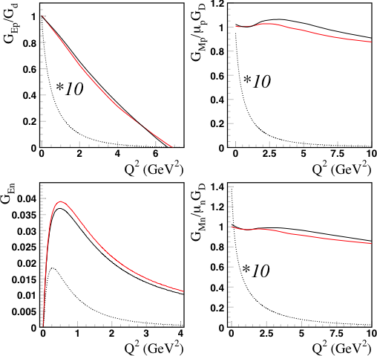
Nucleon – q³ + pion cloud
form (I)
form (II)
N=q³+π; m_{q}(Q²)
Pion cloud contributions:
Significant for G_{en} at Q²<2-3GeV²
Negligible for other F.F. at Q²>2GeV²
From G_{Ep}(0)=1 follows that
|N> = 0.95|q³> + 0.313 |Nπ>
pion
pion
pion
pion

Slide 9
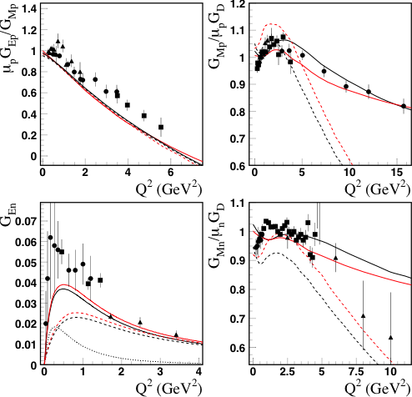
Nucleon electromagnetic form factors
form (I)
form (II)
N = q³; m_{q}(0)
N = q³+π; m_{q}(Q²)
Combining (1) with form (I) gives results that are comparable to results when combining (2) with form (II)
The running of m_{q}(Q²) allows for the description of G_{Mp} at Q² < 16 GeV² within the LC rel. quark model.

Slide 10
Excited nucleon states
No calculations available that allow separation of |q³> and |Nπ> (|Nm>) contributions to nucleon resonances.
  Coefficient c* in |N*> = c*|q³>+..., c* <1, is unknown.
  Weight of c_{N}c*<N*=q³|J_{em}|N=q³> in <N*|J_{em}|N> is not known.
Determine weight factor by fitting to the experimental amplitudes at Q²≈2-3GeV² assuming that the transitions amplitudes are dominated by the q³ core, as is the case for the nucleon e.m. form factors.
All other parameters of the model are taken from the description of the nucleon form factors.

Slide 11
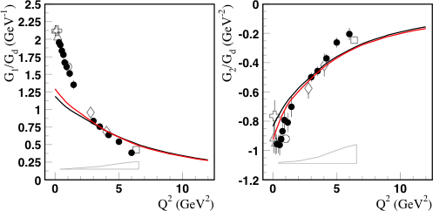
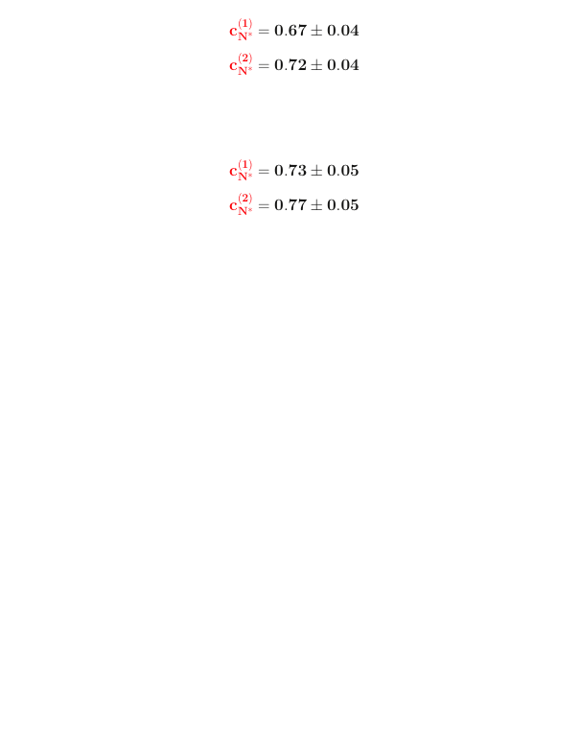
Delta resonance P₃₃(1232)
q³ weight factors:
Pion cloud effects
G₁(Q²) ~ (G_{M} – G_{E})
Model uncertainties of amplitudes extracted from CLAS data by Jlab group.
Taking into account the systematic uncertainties in the data, the Q² -dependence of the form factors is described well at Q² > 3 GeV².

Slide 12
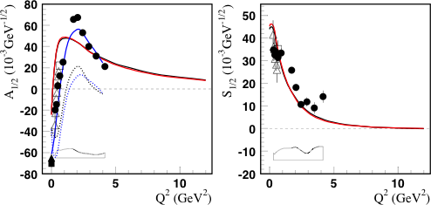
The Roper resonance P₁₁(1440)
q³ weight factors:
JLab/CLAS
JLab/CLAS
Maid
For A_{1/2} the model predicts slower fall off with Q² than observed in the data.
The estimated meson cloud contribution for A_{1/2} shows a non-trivial Q² – dependence

Slide 13
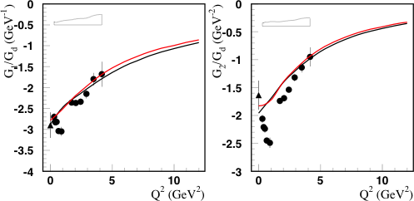
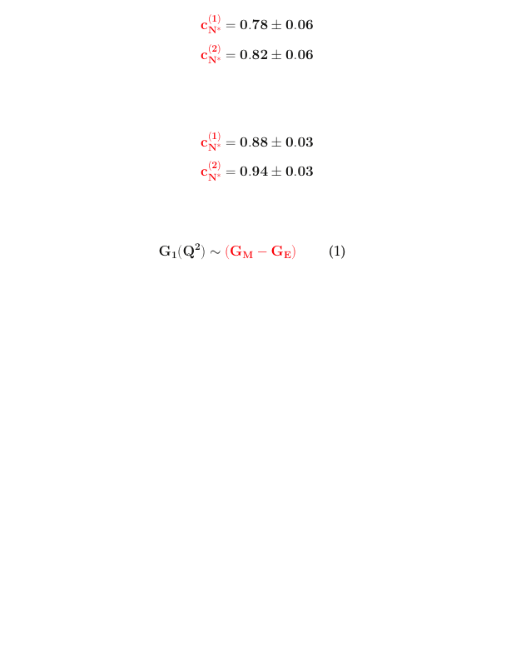
The D₁₃(1520) resonance
q³ weight factors:
G₁(Q²) ~ (A_{1/2} – A_{3/2}/√3)
G₂(Q²) = f(A_{1/2}, A_{3/2}, S_{1/2})
Meson-cloud effects
Q² -dependence of the form factors is described by the model at Q²>2.5 GeV².

Slide 14
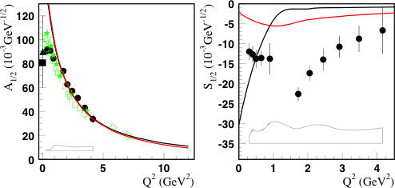
The S₁₁(1535) resonance
q³ weight factors:
Nπ data CLAS
pη CLAS/Hall C
The weight of the q³-core contribution is found from the transverse amplitude at Q²=2GeV². Predictions for Q² ≤ 7GeV² agree well with the data.
Quark model results for S_{1/2}(Q²) amplitude depend strongly on the model parameters. Large meson contribution, and possibly additional contributions are needed.

Slide 15
Conclusions
We obtain good description of the nucleon electromagnetic form factors at Q² < 16GeV² in light-front dynamics that includes q³ and π-cloud contributions.
  close results are obtained for two widely used N=q³ wave functions
Running of the constituent quark mass m_{q}(Q²) is essential to achieve good description in a wide Q² range.
Qualitative agreement with QCD lattice calculations and Dyson-Schwinger equations.

Slide 16
Conclusions cont’d
At Q² > 3 GeV² the model describes several electro-excitation amplitudes for major low mass states Δ(1232), D₁₃(1520), S₁₁(1535).
Predicts quark-core contributions for Q² = 5-12 GeV².
The models predicts flatter than observed A_{1/2} amplitude for the Roper P₁₁(1440). There is a need for data at higher Q² to check the Q² evolution.
At Q² < 3 GeV², we expect significant meson-cloud effects for
  P₃₃(1232) - G_{M}*(Q²)
  P₁₁(1440) - A_{1/2}(Q²)
  S₁₁(1535) - S_{1/2}(Q²)
  D₁₃(1520) - G₂(Q²) transition form factor
S₁₁(1535) – A_{1/2}(Q²) indicates meson cloud effects only at Q² < 1 GeV².
Measurements of N* transition form factors do probe the running of m_{q}(q)!

Slide 17
Outlook
Data for resonances at masses > 1.6 GeV, and Q²> 2 GeV² are expected from the analysis of CLAS runs in nπ⁺, pπ⁰, and pπ⁺π⁻ channels (talks by K. Park, M. Ungaro in session I-A)
N* transition form factors at Q² ≤ 12 GeV² will be measured after the JLab 12 GeV energy upgrade with the CLAS12 spectrometer.
In a scheme where the quark mass is generated dynamically, quarks may have their own anomalous magnetic moments, and their own form factors. These should be incorporated in model predictions.
Introducing quark form factors will cause a faster Q² fall-off of the transition amplitudes in the quark model. This will force m_{q}(q) to drop faster with Q² to describe the data, bringing it in closer agreement with DSE and LQCD.

Slide 18
Additional slide

Slide 19
The S₁₁(1535) resonance
The weight of the q³-core contribution is found
from the transverse amplitude at Q²=3-4GeV². Higher Q² ranges are predictions, and agree well with the data.
Quark model results for longitudinal amplitudes depend strongly on the model parameters.
Large meson cloud or other contributions are needed to describe the longitudinal amplitude.

